Slide 1
Day 4 - Uttam Shauch

Slide 2
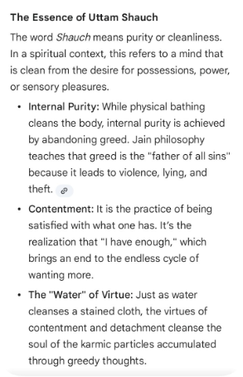
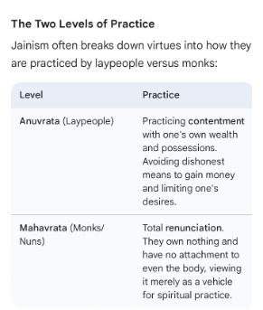
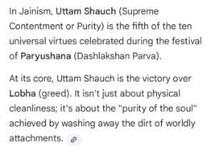
Day 4 of Das Lakshan Parva is dedicated to Uttam Shauch, which represents supreme cleanliness, purity, and contentment.

Slide 3
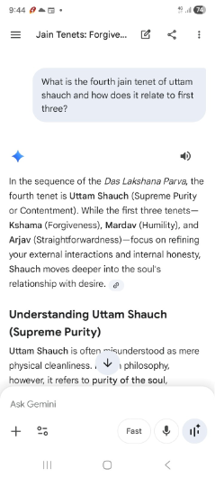
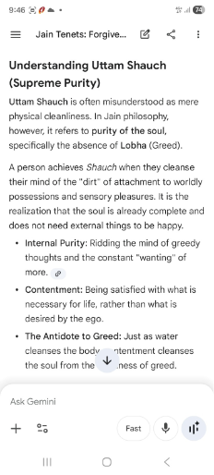
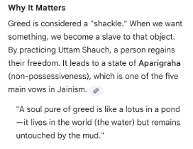

Slide 4
